Slide 1


Slide 2




Our team
Daniel Schneiderman
Moshe Ofer
Yehonatan Friedman
Hagay Kronovich
314790197
1212121212121
207689647
318813367

Slide 3
Contributions
BarrelSnap wouldn’t be as it is, if not for the great team members and the contributions of each one.
Yehonatan | Business pages
Hagay | Customer pages
Moshe | Interface the app to Firebase, login page
Daniel | Guarding the border of Israel (: Plan the system and functionality, interface the app to firebase storage for images.

Slide 4
About

Slide 5
BarrelSnap is a revolutionary mobile application designed to empower wineries and connect them directly with wine lovers who crave unique vintages. We offer a one-stop solution for wineries to seamlessly manage their barrels, from tracking inventory and monitoring aging to scheduling tasks and connecting with potential buyers. For consumers, BarrelSnap opens doors to a curated selection of exceptional wines crafted by passionate winemakers who utilize our barrel management tools

Slide 6
Why BarrelSnap
For Wineries
Save time and resources
Reach new costomers
Build brand loyalty
Streamline operations
For Consumers
Discover exceptional wines
Support independent producers
Find your perfect bottle
Connect with the makers
Convenient ordering

Slide 7
Features

Slide 8
Features for wineries
Barrel Management (to do)
01
02
Track inventory, monitor aging conditions, and schedule tasks all in one place.
Receive timely alerts for key activities like topping and racking.
Generate reports to gain insights into your barrel data.
Manage your wine inventory, track sales, and update your profile information.
Add new wines, update listings, and remove items as needed.
View and manage incoming orders from clients.
Business Dashboard

Slide 9
Features for wineries
Direct-to-Consumer Sales (to do)
03
Showcase your wines and tell your story to a wider audience.
Interact with potential buyers in real-time and answer their questions.
Process orders efficiently and communicate updates directly with clients.

Slide 10
Features for consumers
Wine Discovery
01
02
Explore an extensive wine catalog featuring diverse regions, varietals, and price ranges.
Use search and filter tools to find wines based on your preferences.
Discover new favorites by reading tasting notes, ratings, and reviews.
Place orders directly from the app and choose your preferred delivery or pickup option.
Enjoy seamless ordering and delivery options directly from the app.
Track your orders and receive notifications on delivery status.
Ordering & Delivery

Slide 11
Features for consumers
03
Connect with Wineries (to do )
Follow your favorite wineries and stay updated on their latest releases and events.
Engage with winemakers, ask questions, and participate in virtual tastings and events.
Receive personalized recommendations based on your preferences and purchase history.

Slide 12
Diagrams

Slide 13
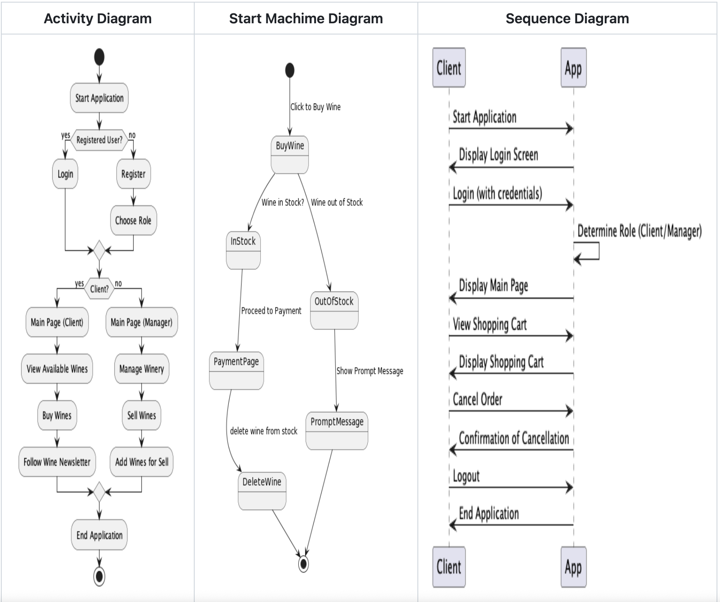
Diagrams
Awareness
Interest
Decision
Purchase
Venus is the second planet from the Sun
Saturn is composed of hydrogen and helium
Jupiter is the biggest planet of them all
Mercury is the closest planet to the Sun

Slide 14
Tools

Slide 15
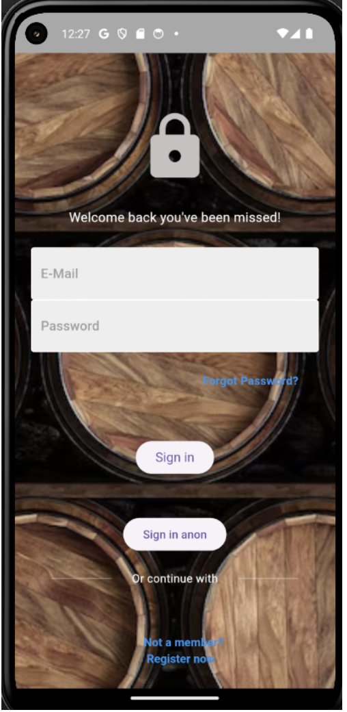


Framework for building cross-platform mobile applications.
mobile
Authentication + FireStore db + storage

Slide 16
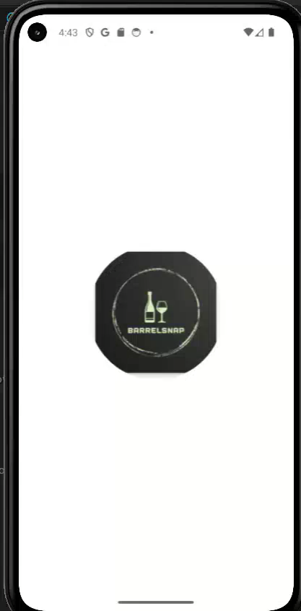

Slide 17
Future Work

Slide 18
What to look for
UI Improvement and Optimization
Work and finish features and functionality

